Slide 1
Freemium Project
Jason Cai, Sarah Zhao, Wendy Yu

Slide 2

Overview
Helping the HighNote music streaming website to predict adoption of free users to premium subscribers on their freemium model
The dataset contains user data with prior, current, and future features
In this presentation, we will go over our methodology, analysis, recommendation, limitations, and possible next steps

Slide 3
Methodology
Two predictive models
1. How likely free users are to become adopters of the premium subscription
2. Predicting future engagement using current and prior features from users
“Delta2engagement” feature
Replacing missing values with zeros
KNN model randomly selects features and runs multiple times

Slide 4
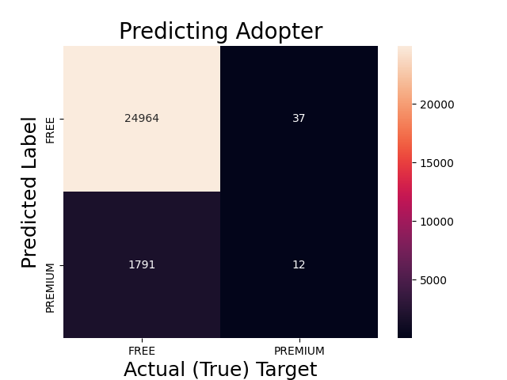
Analysis
First prediction - Logistic regression
A score of about 93% accuracy
Low variance of less than a 1% difference between the testing and training data
12 users will switch to premium
24,964 users will remain free, only 1,828 samples wrongly predicted
Second prediction
All the models we tried are not egligible predictions for future engagement
Accuracy scores are low (high bias) with low variance

Slide 5

Recommendations
Use logistic regression to better predict how many users will switch to premium subscription focusing on website’s features in the past
It’s hard to set features in the previous and current periods to better predict engagement in the future, but we can conclude that past and current website data is not closely related to future engagement.

Slide 6
Limitations & Further Analysis
Limitations
Missing values in the dataset
Limited sample size, a larger sample could help with insights
The weight for “1” and “0” in the original dataset is highly imbalanced
Create new features that track logins per day and hours spent online per day

Slide 7
Thank you !

